Slide 1

WEEK 0
DAY 0
What is CS?
Notes:
This is a quick lecture.
Use this opportunity to encourage student participation, instead of making it a 1-way dialogue lecture.
Set the classroom dynamic here!
Lectures are a 2-way dialogue between students and teachers.
Ask engaging questions (many are provided), but be organic and shift in response to student interests.

Slide 2
What is CS?
What is Computer Science?
Programmatic Approach
Where is CS?

Slide 3
WHAT IS COMPUTER SCIENCE (CS)?
Notes:
Ask students question (not eliciting any one in particular)
Go to next slide to help get dialogue started

Slide 4












Notes:
“Here are some industry leaders in computer science to help give you some ideas”
“Computer science is one of the key reasons for the success of all these companies”
Can restate questions “What is computer science?”

Slide 5
MORE THAN ONE ANSWER!

Slide 6
MAIN CONCEPT...
Using computers to solve problems
Notes:
When it comes down to it, computer science is the idea of using computers to solve problems

Slide 7
PROBLEM?
Which problems are easiest for a computer to solve?
Notes:
Elicit examples from students
Then move onto next slide with more examples

Slide 8
PROBLEM?
Which problems are easiest for a computer to solve?
Math - Find the factorial of 500

Slide 9
PROBLEM?
Which problems are easiest for a computer to solve?
Math - Find the factorial of 500
Storing information - Databases

Slide 10
PROBLEM?
Which problems are easiest for a computer to solve?
Math - Find the factorial of 500
Storing information - Databases
Matching (words)- Search Engine

Slide 11
PROBLEM?
Which problems are harder to solve?
Notes:
Elicit examples from students
Then move onto next slide with more examples

Slide 12
PROBLEM?
Which problems are harder to solve?
Language Processing - Translate English to Spanish

Slide 13
PROBLEM?
Which problems are harder to solve?
Language Processing - Translate English to Spanish
Weather - Forecast predictions

Slide 14
PROBLEM?
Which problems are harder to solve?
Language Processing - Translate English to Spanish
Weather - Forecast predictions
Matching (humans) - Finding your true love

Slide 15
WHAT TO DO...
These problems are difficult

Slide 16
WHAT TO DO...
These problems are difficult
Computer Science takes a problem and solves it using an approach called…

Slide 17
THE PROGRAMMATIC APPROACH
Notes:
Ask students: “What might be the first step in solving one of these problems?” elicit: “An idea!”

Slide 18

THE PROGRAMMATIC APPROACH
IDEA
Notes:
Ask students: “What might be the first step in solving one of these problems?” elicit: “An idea!”

Slide 19
THE PROGRAMMATIC APPROACH
Representation/Abstraction
Notes:
The next step is not as intuitive for students, so simply, discuss it.

Slide 20
THE PROGRAMMATIC APPROACH
Representation/Abstraction
Translate idea into something computers understand

Slide 21
THE PROGRAMMATIC APPROACH
Representation/Abstraction
Translate idea into something computers understand
What do computers understand?
Notes:
Ask “What do computers understand?” elicit: “numbers” and/or “logic”

Slide 22
THE PROGRAMMATIC APPROACH
Representation/Abstraction
Translate idea into something computers understand
What do computers understand?
Numbers
Logic
Notes:
The next step is not as intuitive for students, so simply, discuss it.
Ask “What do computers understand?” elicit: “numbers” and/or “logic”
Last question is rhetoric. We’ll discuss this at length in time.

Slide 23
THE PROGRAMMATIC APPROACH
Representation/Abstraction
Translate idea into something computers understand
What do computers understand?
Numbers
Logic
How do we represent our dreams to a computer?
Notes:
Last question is rhetoric. We’ll discuss this at length in time.
“2nd to last step is…”

Slide 24
THE PROGRAMMATIC APPROACH
Algorithm
Notes:
Ask: students what an Algorithm is. Not eliciting any particular answer, just get a general sense of what students understand at this point.
Explain:
Definition of Algorithm: A list of step-by-step instructions for how to complete a task.
Example: A recipe is an algorithm for how to turn a list of ingredients into the final cooked dish.
Explain that breaking down a problem into steps that a computer can solve requires algorithms. An algorithm is a set of step-by-step instructions for how to complete a task. You already follow lots of algorithms in your daily lives, like when you get dressed for the day or walk to a friend's house.

Slide 25
THE PROGRAMMATIC APPROACH
Algorithm
What are the steps computer must take to solve problem?
Notes:
Explain this as the step before we actually do any coding. It’s just setting up for the finale!

Slide 26

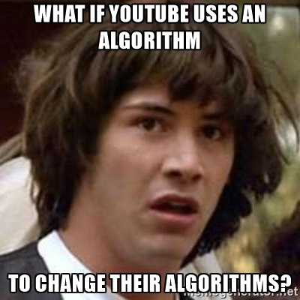
THE PROGRAMMATIC APPROACH
Algorithm
What are the steps computer must take to solve problem?
Notes:
For example, YouTube uses an algorithm to predict what videos you’d want to watch

Slide 27

THE PROGRAMMATIC APPROACH
Code
Notes:
The last, and easiest step!

Slide 28
THE PROGRAMMATIC APPROACH
Code
Make the thing!
Actually, this is the EASY part!
Notes:
Explain why this step is “easy”
Ask students “How much time (percentage) do you think real developers and programmers spend ACTUALLY coding?” elicit a few answers before explaining, “About 20-30% of the time developers write actual code. The VAST majority of the time you will spend DEBUGGING!”
(SIDE NOTE: revisit this concept late in the Summer Intensive whenever students get hung up on projects: if students get stuck in the planning and coding phase of a project, reinforce the idea that they should get to debugging sooner, rather than later, because that’s where they should be spending the most time!).

Slide 29
WHERE IS COMPUTER SCIENCE?
Notes:
Ask students where we can find computer science in our lives?
Elicit a few responses before moving on.

Slide 30

WHERE IS COMPUTER SCIENCE?
Every electronic device you’ve ever used and ever will use
Notes:
Ask: Give specific examples of electronic devices?
Answer: Cell phones, computers, electric cars, etc

Slide 31

WHERE IS COMPUTER SCIENCE?
Video Games
Notes:
Ask: Give specific examples of video games?
Answer: Temple Run, Warcraft, Dungeons of Dragons

Slide 32
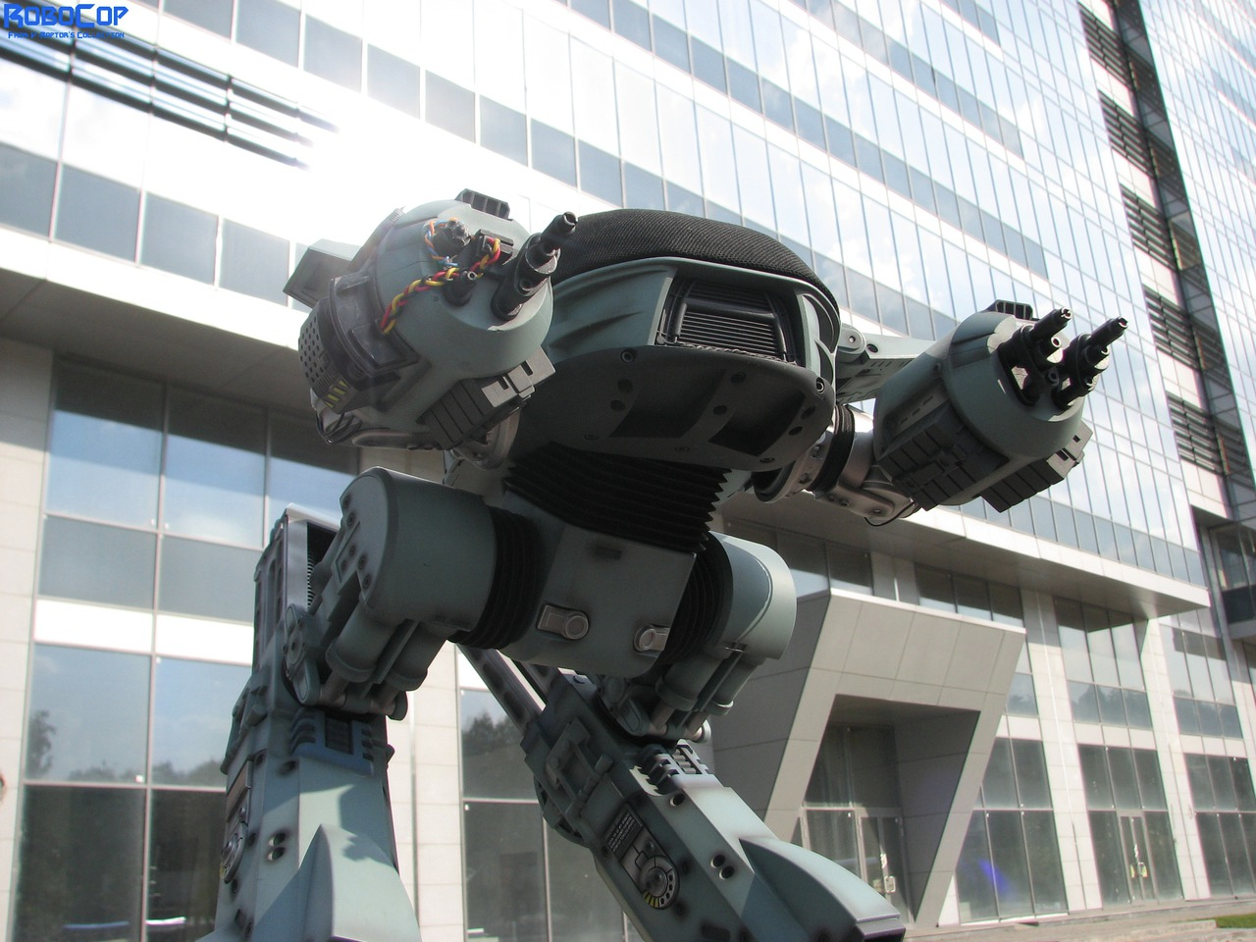
WHERE IS COMPUTER SCIENCE?
Robots
Notes:
Ask: Give specific examples of where robots are used in today’s society?
Answer: Manufacturing assembly line, agriculture, ATM machines
(Props if students get this movie reference! “ED 109 from RoboCop”)

Slide 33
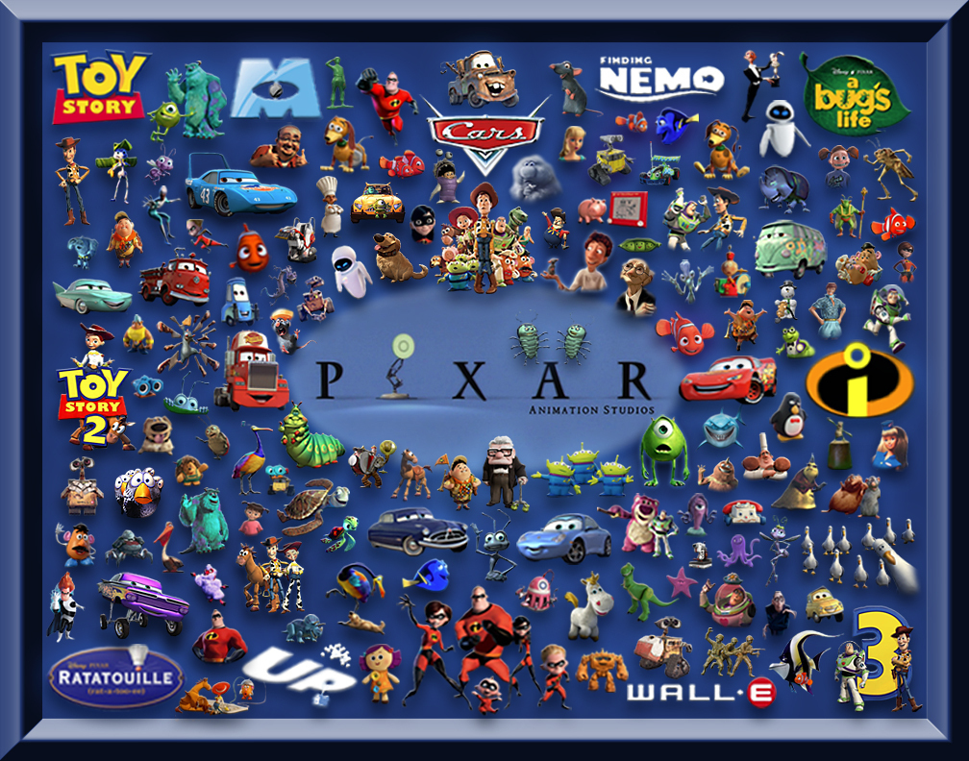
WHERE IS COMPUTER SCIENCE?
Animated Movies
Notes:
Ask: Give specific examples of animated movies?
Answer: Toy Story, The Incredibles, cars, Monster, Inc, Wall-E

Slide 34
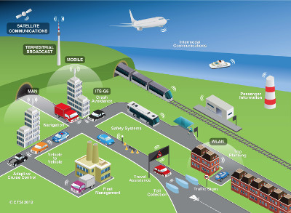
WHERE IS COMPUTER SCIENCE?
Transportation
Notes:
Ask: Give specific examples of where in Transportation is Computer Science used?
Answer: Air flight control, traffic light system, railroad system

Slide 35
WHERE IS COMPUTER SCIENCE?
Code
Notes:
Explain: What powers all our electronical devices, video games, robots and movies is code. Programming or code is what makes all these technology work.

Slide 36
CAREERS IN COMPUTER SCIENCE
Web Engineer
Frontend Developer
Backend Developer
Full-Stack developer
Mobile Engineer
Android Developer
IOS Developer
Data Engineer
Dev-ops Engineer

Slide 37
WHERE YOU COME IN
The ASC Summer Intensive
Will teach you how to turn your ideas into code to solve problems

Slide 38
THE LAST PROJECT - DEMO DAY PROJECT
Create a mobile application or a web application that does one of the following:
addresses a problem you see in your community
saves the user money (even 1 cent counts!)
addresses a social justice issue. Some issues include, but are not limited to:
Poverty
The environment
Access to education
Access to health care
Inequality (sex, race, nationality)
(Games are OK! Limit of 2 per cohort)
Notes:
Explain: A mobile application is an app that functions inside a cell phone. A web application works and is accessible via the browser and the internet.
Let students absorb the last project
Even though they’re a ways off from being able to it, it’s important for students to see what the end looks like as a motivational tool
Students can already begin to be impressed by their future selves, since they know by the end of the program they’ll be capable of doing this.

